Slide 1


Welcome Home! Internet Open Telemetry Martin Hron security researcher

Slide 2

Welcome to the age of speed and security!
“A computer lets you make more mistakes faster than any invention in human history - with the possible exceptions of handguns and tequila.”
Mitch Ratliff

Slide 3
So let’s talk about the IoT

Slide 4

Personal story
Following part of the presentation contains best practices violation, domestic violence on devices, broken security and self-confidence.

Slide 5
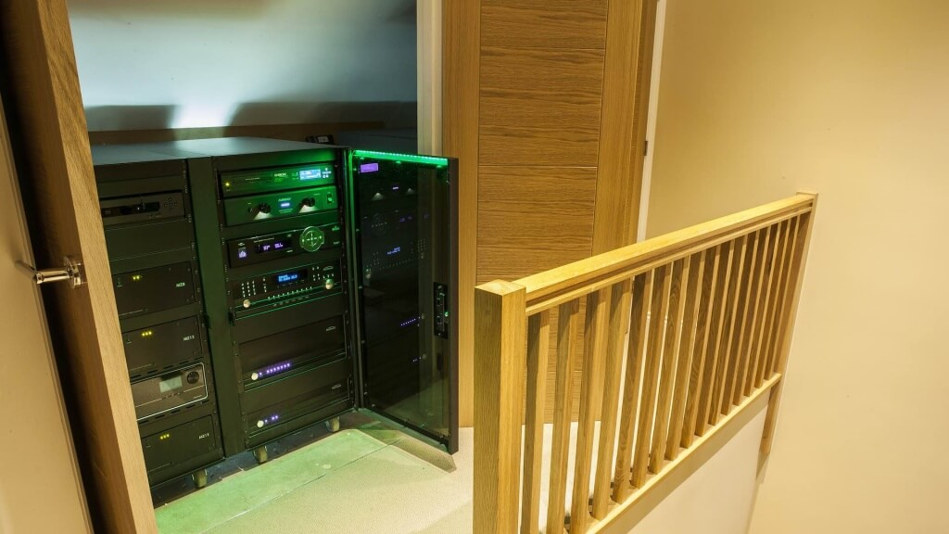
Personal story: How has it started
I bought a house
I dreamt of home automation
I was confident enough that I’m able to achieve it in a DYI way.

Slide 6
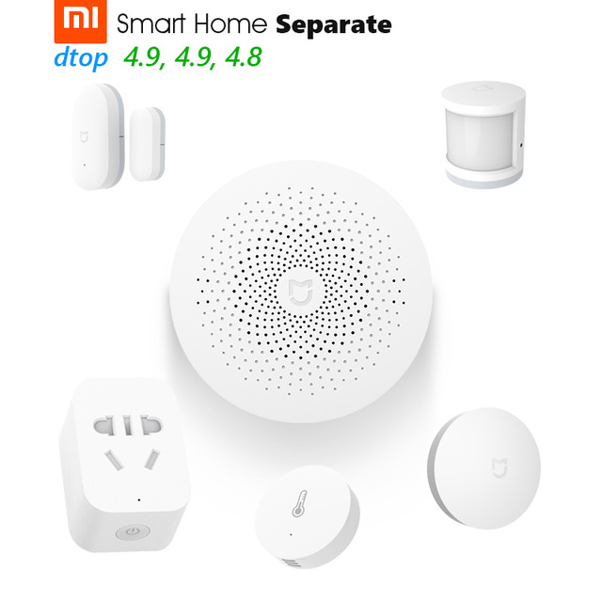
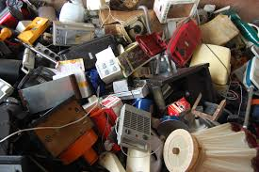
Personal story : options
use one vendor and one solution, one cloud
You’ve got a bunch of devices from different vendors or even dumb devices

Slide 7
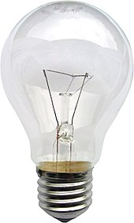
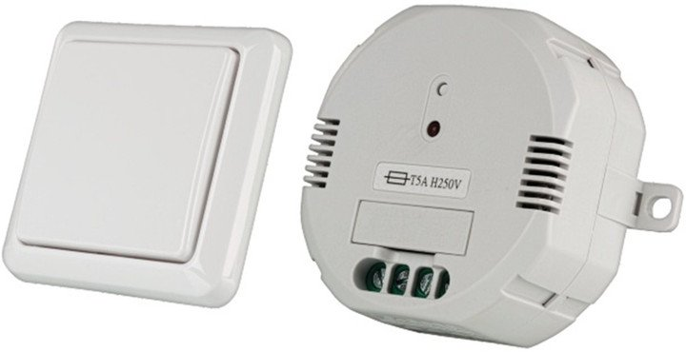
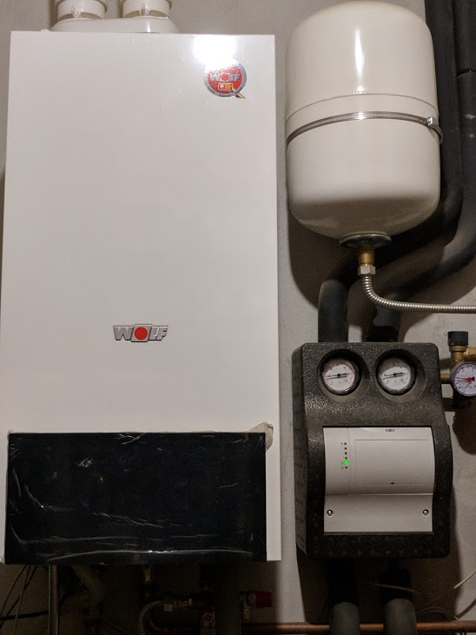
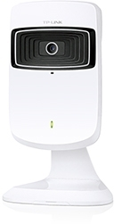
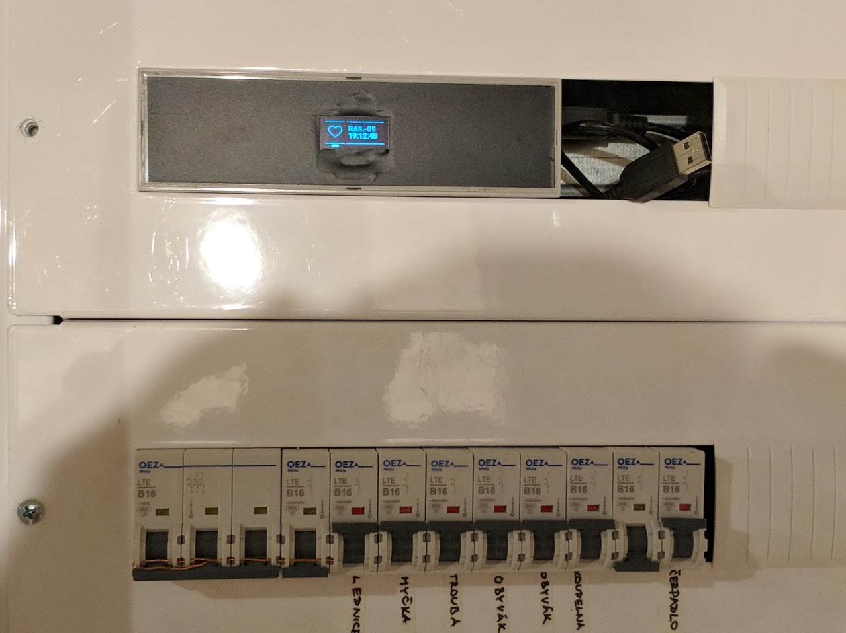

Slide 8
Personal story
Some devices might be exotic.

Slide 9
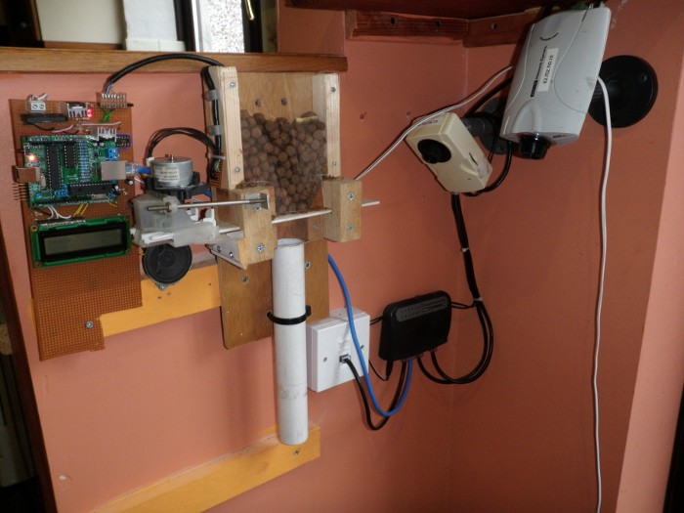

Slide 10
Personal story
I had mixture of devices and a was dreaming of nice rig for my “smart hub” and all the equipment. Dreaming about a house where everything just happens.

Slide 11
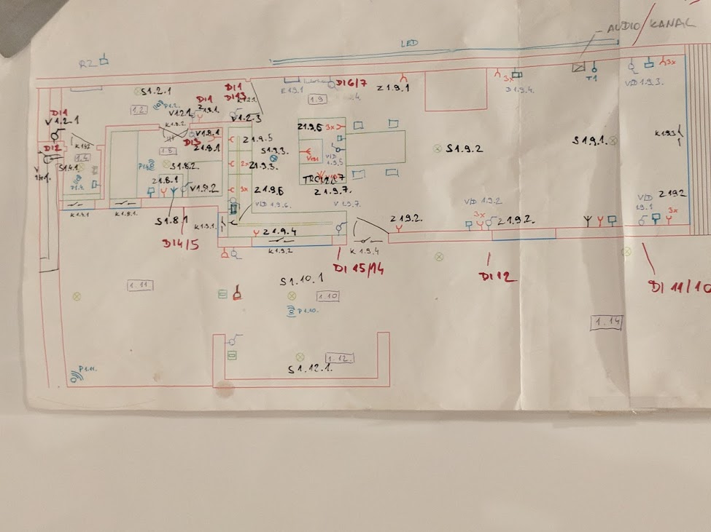

Slide 12
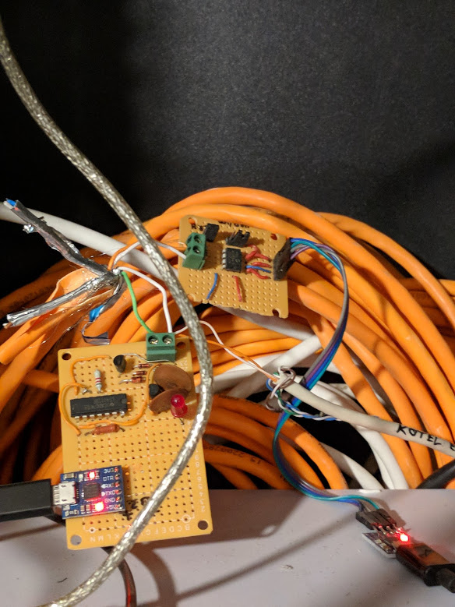

Slide 13
Babylon of “standards”
Physical layer / data link
Bluetooth
RS232, RS485, CAN, eBUS
WiFi, Ethernet
ZigBee
433, 866 MHz
and many others

Slide 14
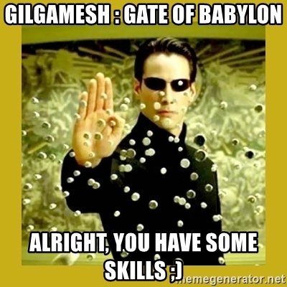
Babylon of “standards”
Transport / application layer
Textual data
JSON
HTTP
XML
Binary oriented protocols
Proprietary protocols

Slide 15


Slide 16
Message Queue Telemetry Transport - MQTT
publisher - subscriber model
payload agnostic
topics can be organized in a tree like structure
when subscribing, wildcards can be used
usually operates through TCP on port 1883
supports the “last will” and persistent topics

Slide 17
MQTT topics
Examples of the topics: /house/attic/light /house/basement/door /house/basement/light
Tree like organized structure. When subscribing, you can use wildcards. # for the all levels from here down the tree or + for any single level.
Subscription to /house/+/light delivers all light topics in any room
Subscription to only # delivers every topic published by anyone to this MQTT server

Slide 18
Typical implementation
Mixture of devices
One namespace
MQTT broker
Business logic
Usually, this also provides some dashboard and a frontend (Domoticz, openHAB, Home Assistant, MQTT dash, Node-Red and many others)

Slide 19
MQTT Broker typical setup of “smart home”
sensor
(switch)
“smart breaker“ box with MQTT support
actor
(dumb bulb)
actor
(smart bulb)
sensor
(switch)
bussines logic
sensor
(door contact)
bridge
MQTT Broker
actor
(garage doors)
sensor
(thermometer)
bridge
bridge
actor/sensor
(heating unit)
simple wire
ZigBee
ETH / WiFi
eBUS

Slide 20
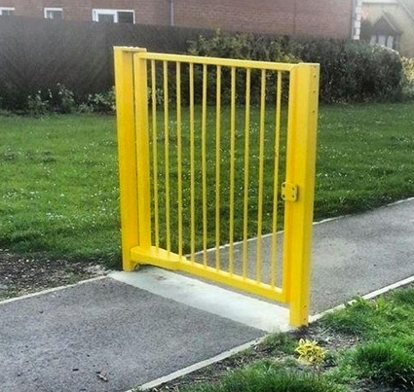
And what about security?
Yes! There is a security!

Slide 21

Welcome home!

Slide 22
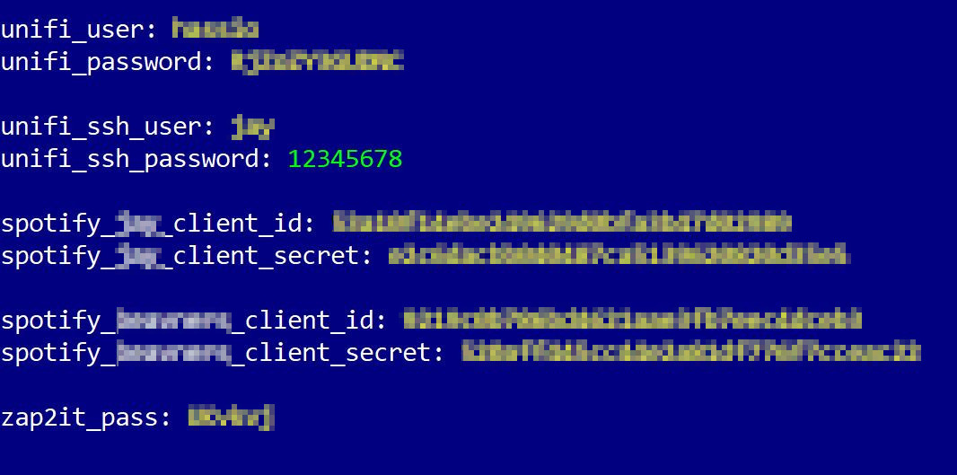
Welcome home!

Slide 23
Welcome home!
Many dashboards have no password set
There are ~49K MQTT servers available to connect
There are ~32K MQTT servers opened without any password set
Remember? You can subscribe to #

Slide 24
Rules of the house
no real exploits
use what is available
cause no harm
even if you are tempted to do so ;)

Slide 25


Slide 26
DEMO TIME

Slide 27

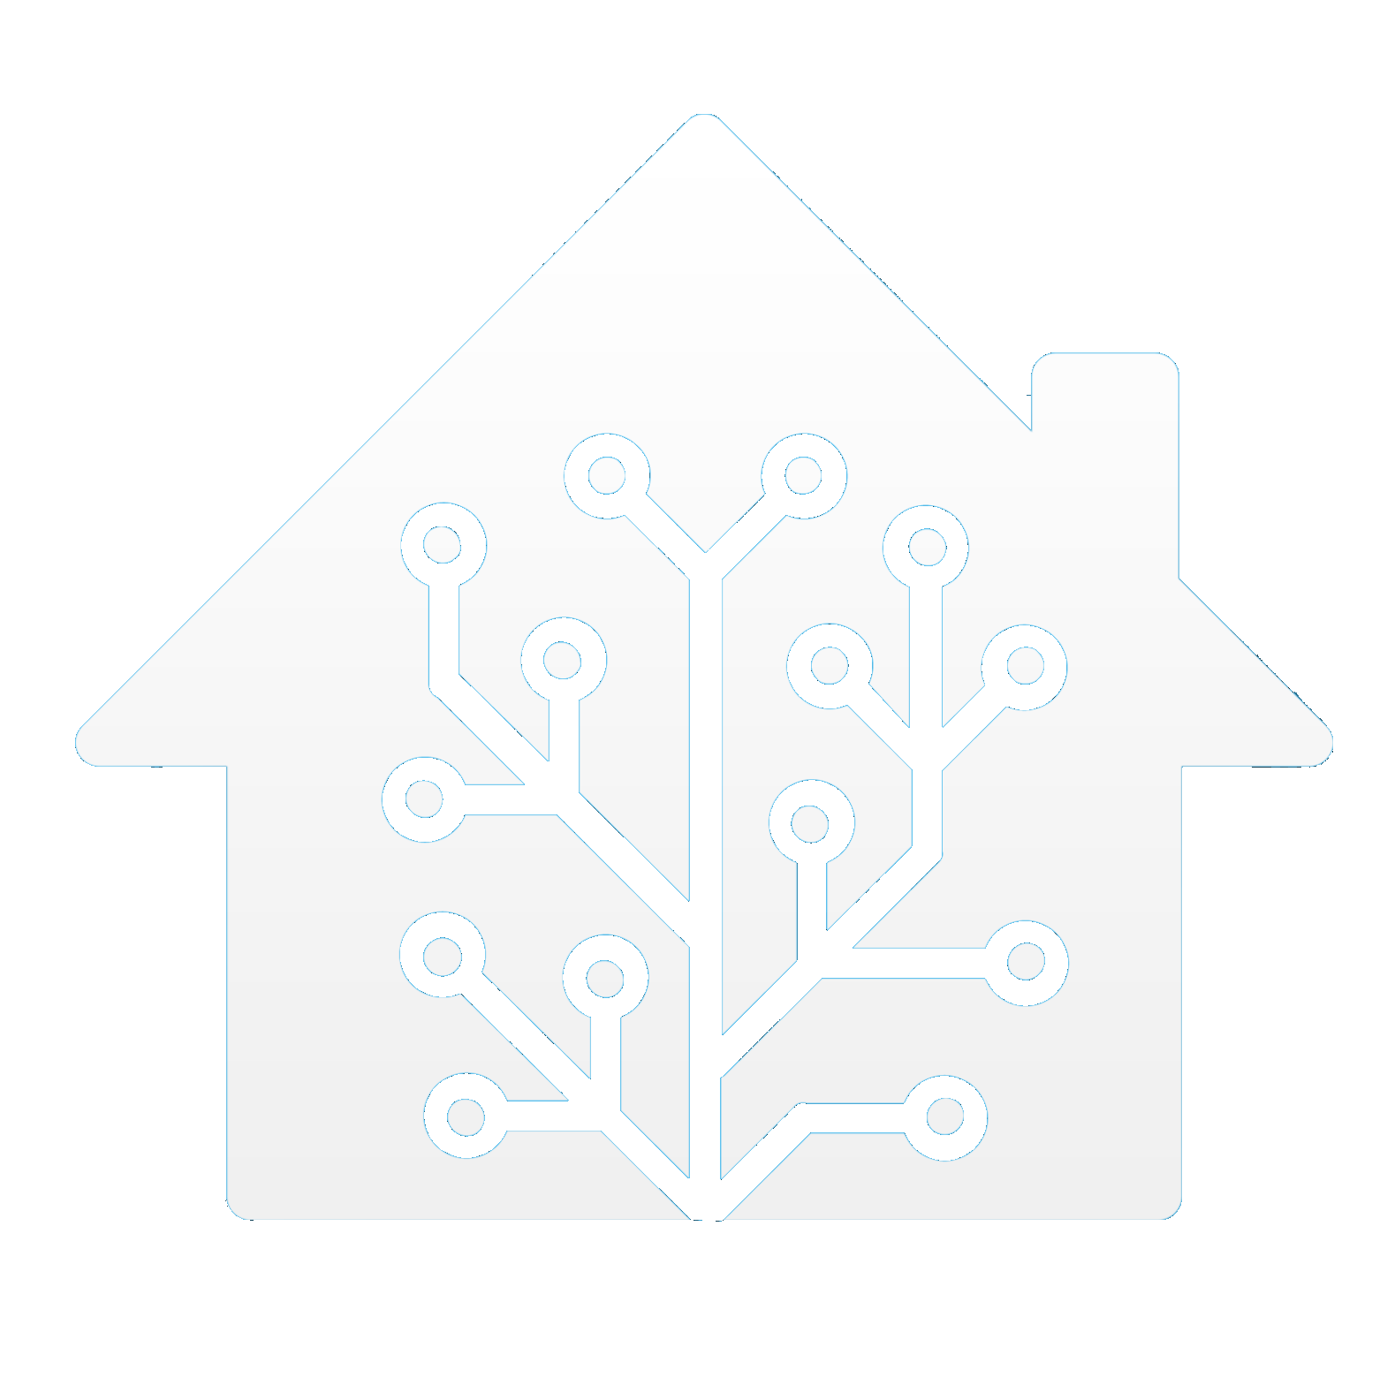


Domoticz
Home Assistant

Slide 28
Home automation software “smart hubs”
Similar concept
Provide business logic
Provide frontend / dashboard
Usually integrate with MQTT and cloud services

Slide 29
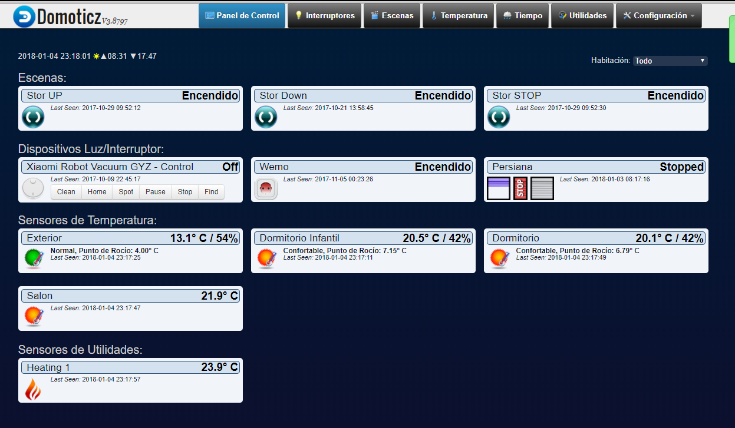
Domoticz

Slide 30
DEMO TIME

Slide 31
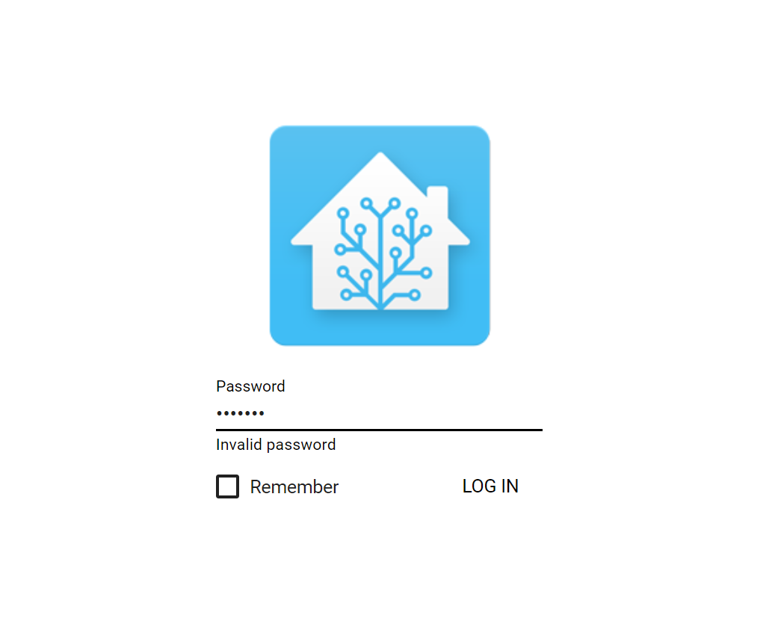
Home Assistant: case study

Slide 32
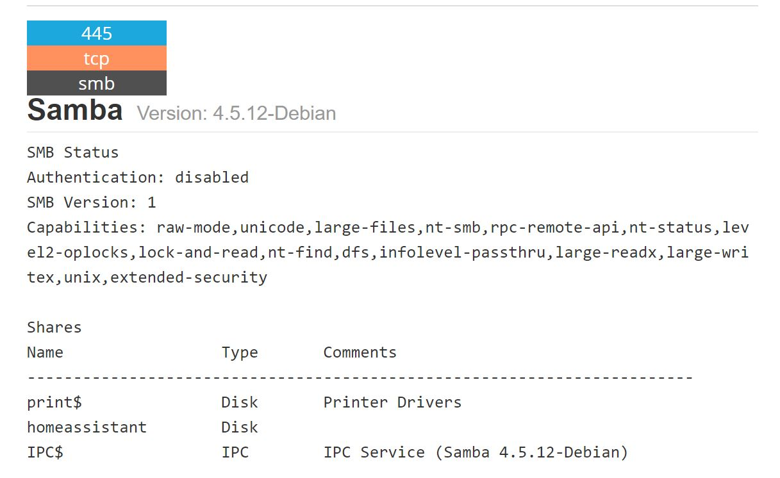
Home Assistant: at the same IP

Slide 33
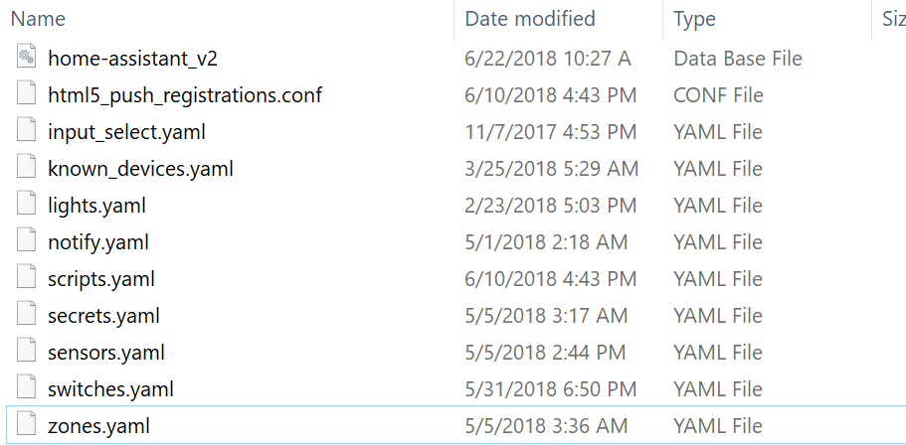
Home Assistant: at the same IP

Slide 34
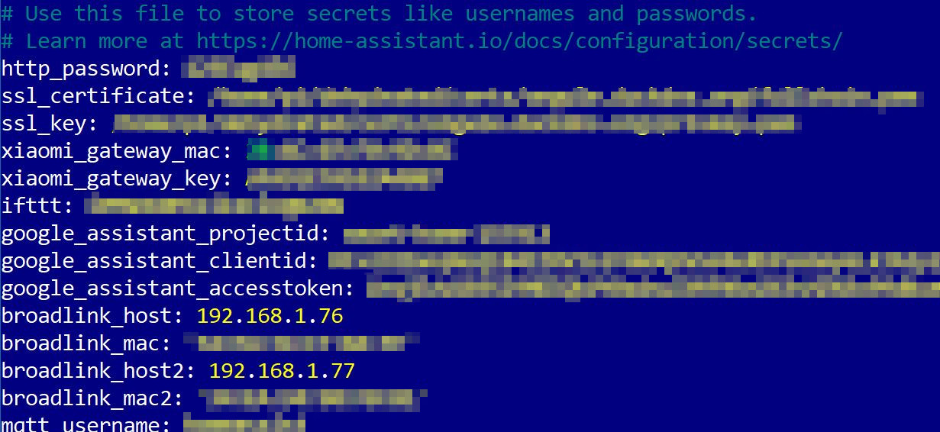
Home Assistant: give me your secrets

Slide 35
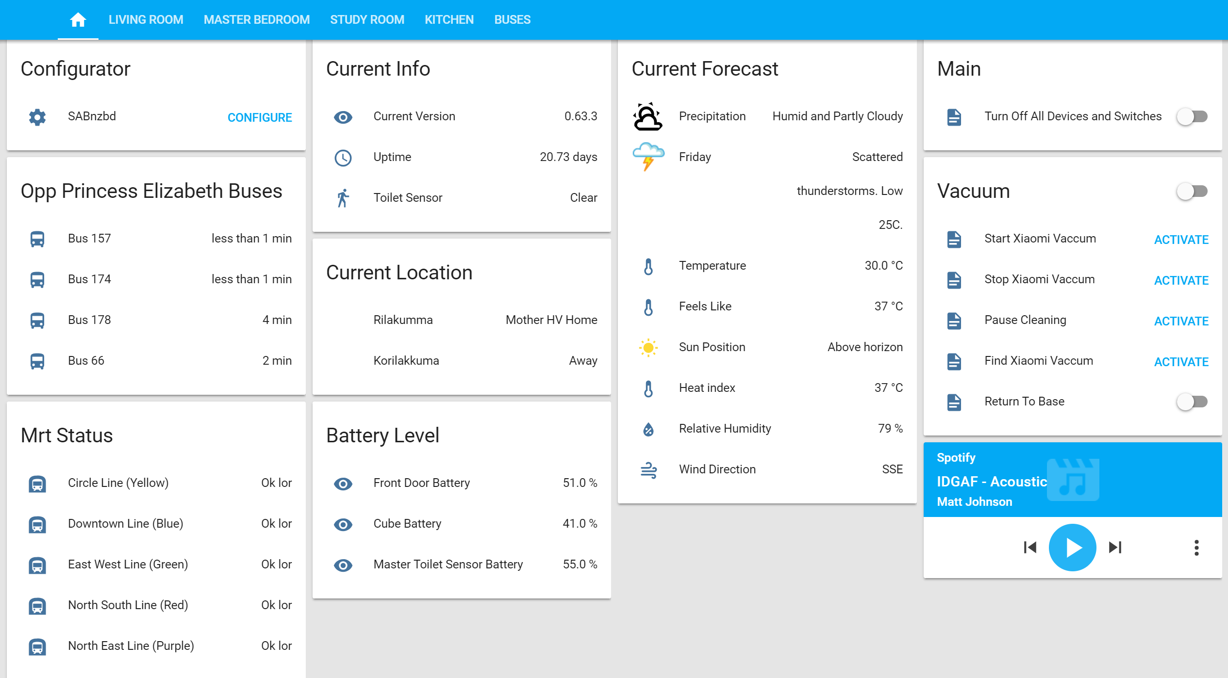
Home Assistant: Welcome Home!

Slide 36
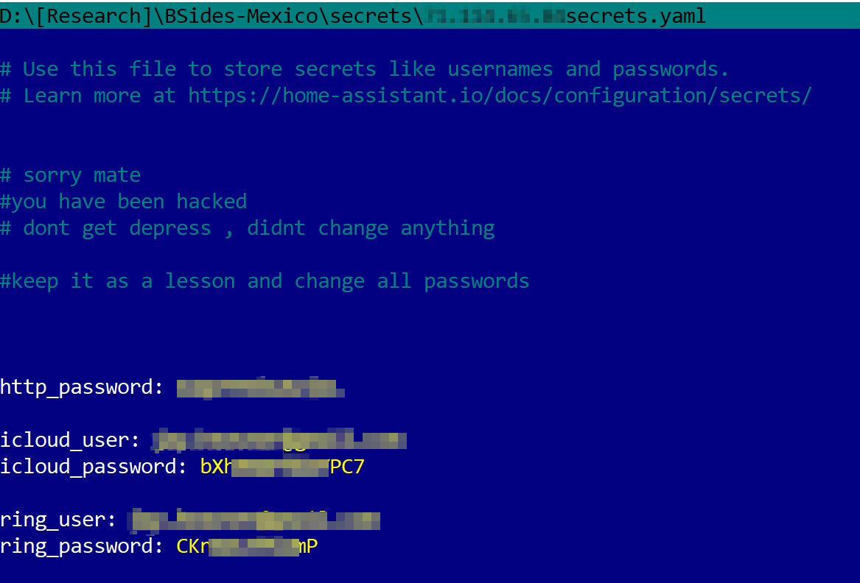
Home Assistant: I’m not the only one

Slide 37
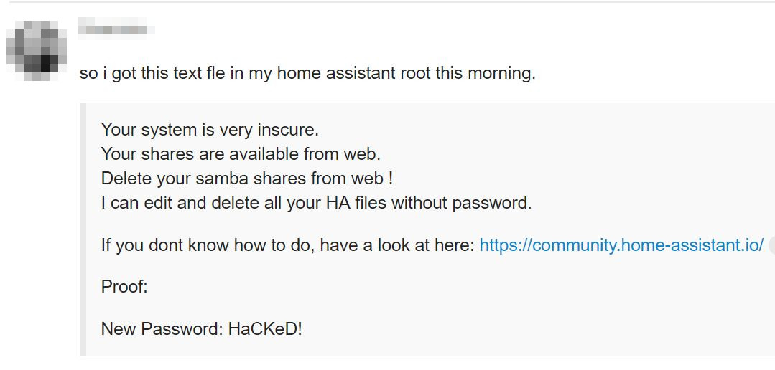
Home Assistant: I’ve been hacked

Slide 38
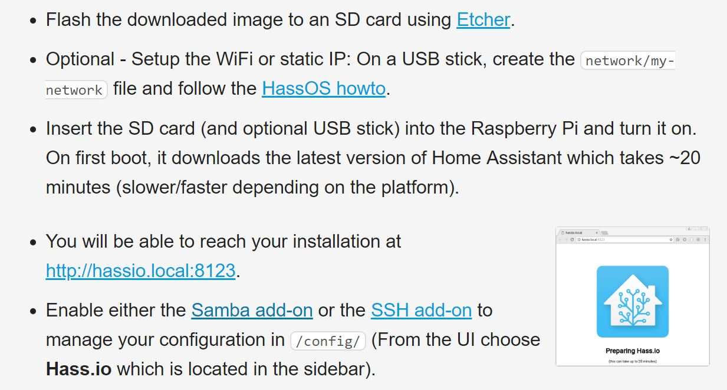
Home Assistant: I’ve been hacked

Slide 39
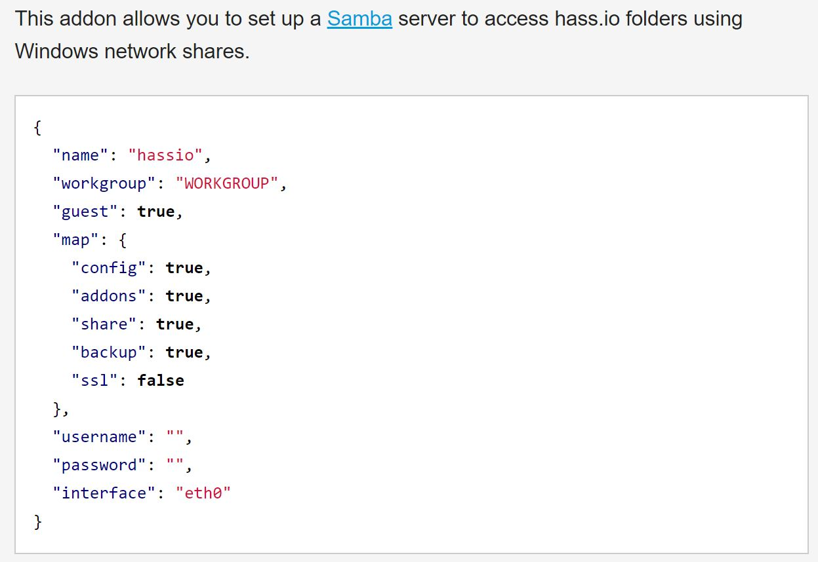
Home Assistant: I’ve been hacked

Slide 40
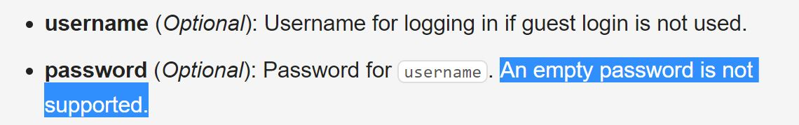

Home Assistant: I’ve been hacked

Slide 41
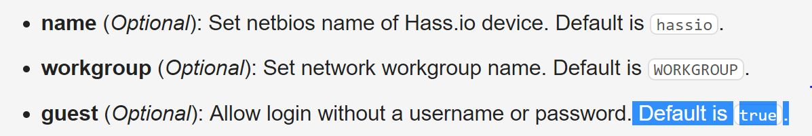

Home Assistant: I’ve been hacked

Slide 42
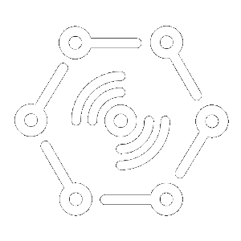
MQTT DASh

Slide 43
MQTT Dash
Simple Android/IOS app
MQTT centric, simple UI that directly reflects state or controls devices through MQTT topics
Interesting concept of storing/loading whole configuration by publishing it to the “persistent” topic

Slide 44
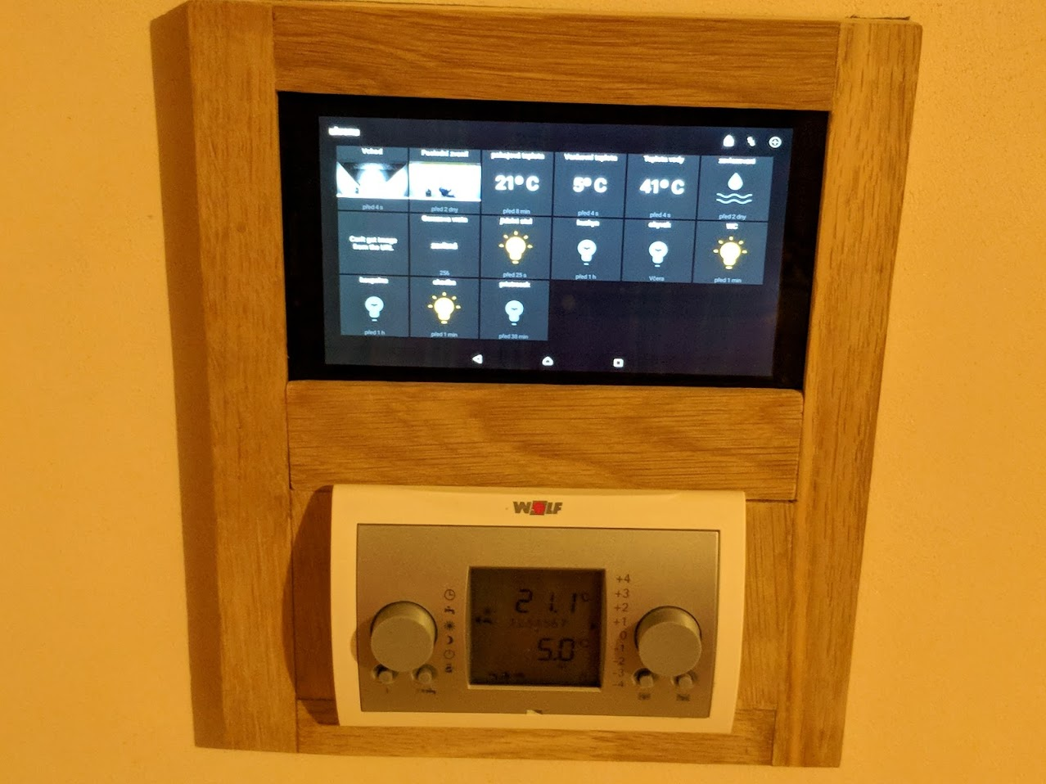

Slide 45
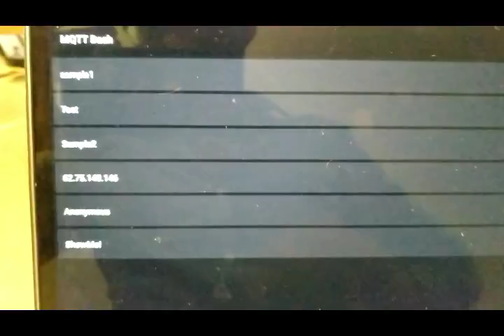

Slide 46
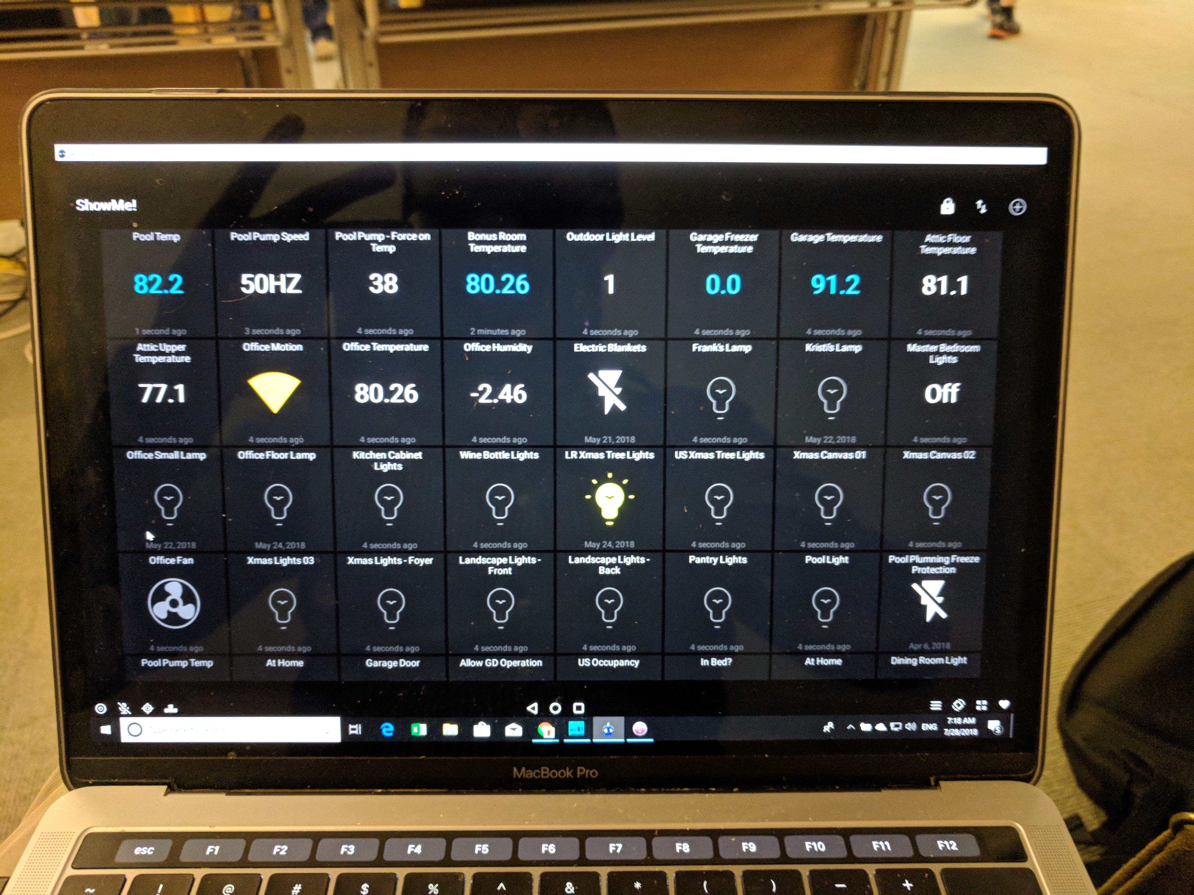

Slide 47

OWNTRACKS
PWNTRACKS

Slide 48
Your “personal” GPS tracker
Basically Android and IOS application for GPS tracking
Supports MQTT
Forget about unsecured cameras, this is even worse.

Slide 49
DEMO TIME

Slide 50
Conclusion
Real world examples how bad the situation is
Educate people more about security
Educate vendors and developers
Let’s stick to the security as an opt-out choice.
DON’T STORE PASSWORDS IN PLAINTEXT
NEVER
EVER

Slide 51
THERE IS ONLY ONE SECURITY
STOP SAYING IoT SECURITY!

Slide 52
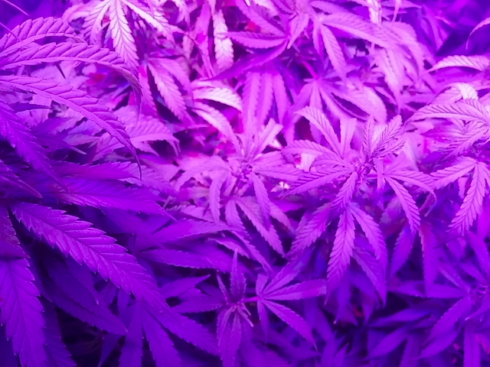
MQTT can be also used for automation of your garden
But the risks could be “high”

Slide 53
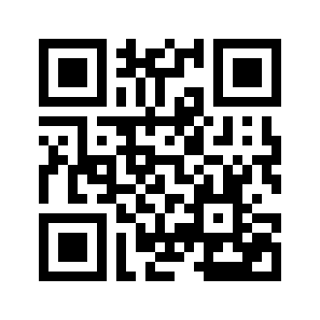
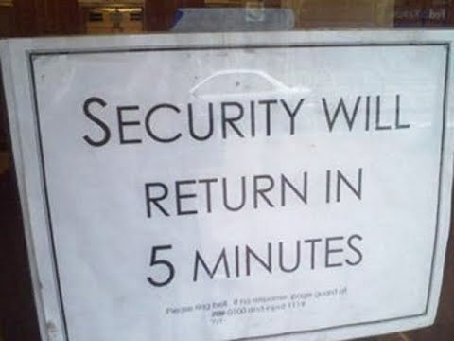



Thank You! Martin Hron
@thinkcz
hron@avast.com
www.avast.com

